Slide 1
SOFTWARE ENGINEERING (15B11CI513 ) Credits :- 4 Contact Hours :- 3-1-0 Project Scheduling

Slide 2
Project Scheduling
Schedule converts action plan into operating time table
Basis for monitoring and controlling project
Scheduling is more important in projects than in production, because unique nature
Sometimes customer specified/approved requirement.
Based on Work Breakdown Structure (WBS)

Slide 3
Activity Planning
Effort estimation
For whole project
For individual activity
Detailed plan
Starting of each activity
End of each activity
Risks

Slide 4
Project Vs Activity
A project is composed of a number of related activities
A project may start when at least one of its activities is ready to start
A project will be completed when all of its activities have been completed

Slide 5
Cont…
An activity should have a duration that can be forecasted
An activity must have a clear start and a clear stop
Each activity should have some ‘deliverables’ for ease of monitoring
Some activities may require that other activities are completed before they can begin

Slide 6
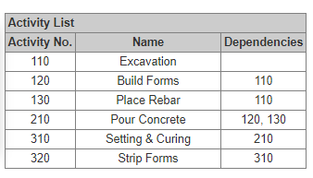

Slide 7
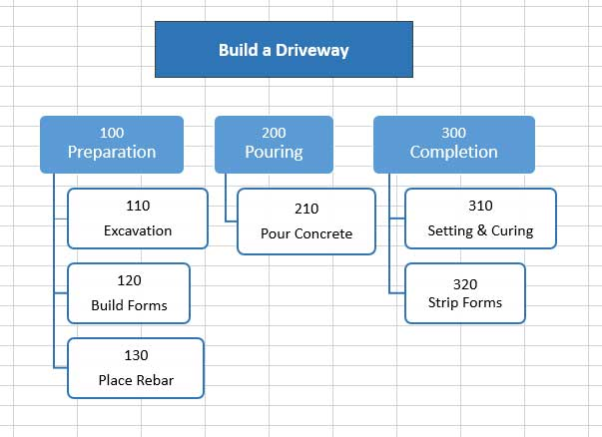

Slide 8
If you’re wondering whether to break down an activity further, ask these three questions:
Is it easier to estimate?
Is it easier to assign?
Is it easier to track?
If the answer is yes to any one, it could be worth breaking down the activity further.
Another way to break down tasks is to ask whether the activity is:
Well understood?
Not well understood?
This is generally an easy distinction to make. Then, if the activity is well understood you are done. But if it’s not well understood:
Separate out the parts that are not understood
Determine why it’s not well understood and perform some more due diligence until it is.
Often there will be a well defined point during the project execution where an activity will transition from “not well understood” to “well understood.”
Maybe some contingencies are needed to get to that point.

Slide 9
Activity Planning
A project plan is a schedule of activities indicating the start and stop for each activity
Also provide the project and resource schedules

Slide 10
Cont…
During planning, managers consider:
Resource availability
Resource allocation
Staff responsibility
Project Monitoring
Cash flow forecasting
Re-planning of the project towards the pre-defined goal
Notes:
Resource available: Make sure the resources are there when needed
Resource allocation: Make sure there are no competing resources.
Staff responsibility: Schedule showing which staff carry out each activity
Project Monitoring: Measure the actual achievement
Cash flow forecasting:Produce a timed cash flow forecast
Re-planning of the project towards the pre-defined goal:re-plan the project so that it will correct drift from the target.

Slide 11
Objectives of Activity Planning
Feasibility assessment
Time and resource constraints
Resource allocation
Timescale and resource availability
Detailed costing
Cost and their timing
Motivation
Co-ordination
Notes:
Once a detailed activity plan is finished, it can be used to achieve the following:
Feasibility assessment: Can the project be delivered on time and within budget (constraints)?
Resources allocation:
How to allocate the resources with best results?
When should those resources be ready?
Detailed costing:
A detailed estimates on the project cost and the timings.
A detailed forecast on when the expenditure is likely to take place.
Motivation:
Providing targets and being able to monitor the achievement of the targets at the end of the activity can be a good strategy to motivate staff.
Co-ordination:
Help to set the time and requirements of staff from different departments to work together in the project, if necessary
Provide a good way for the project teams to communicate, cooperate and collaborate among themselves

Slide 12
Cont…
Activity Planning and scheduling techniques leads to
Completing the project in a min. time and at an acceptable cost
Activities in parallel

Slide 13
Different Levels of Plans
Project Schedule: a plan that shows
What are activities
Order of activities
Dates when each activity should start and stop
When and how much of the resources will be required
Activity Plan: a plan that describes
how each activity will be undertaken
Notes:
The activity plan is done in Steps 4 and 5 of Step Wise framework.

Slide 14
Activity networks

Slide 15
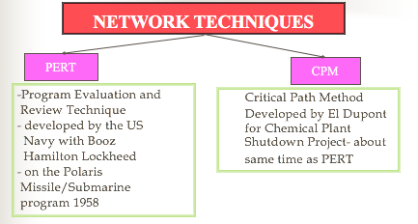
Network Planning Model
Both use same calculations, almost similar
Main difference is probabilistic and deterministic in time estimation
Gantt Chart also used in scheduling

Slide 16
NETWORK
Graphical portrayal of activities and event
Shows dependency relationships between tasks/activities in a project
Clearly shows tasks that must precede (precedence) or follow (succeeding) other tasks in a logical manner
Clear representation of plan – a powerful tool for planning and controlling project

Slide 17
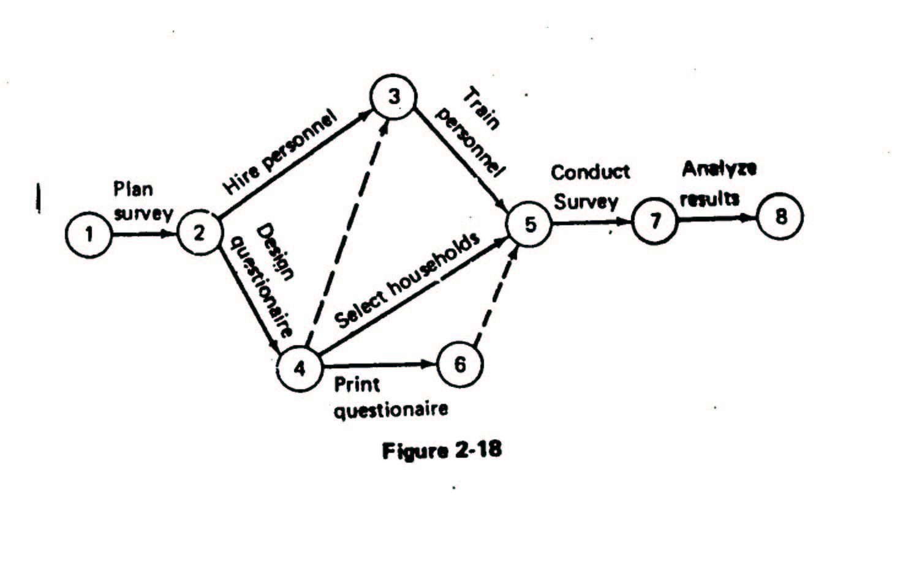
Example of Simple Network – Survey

Slide 18
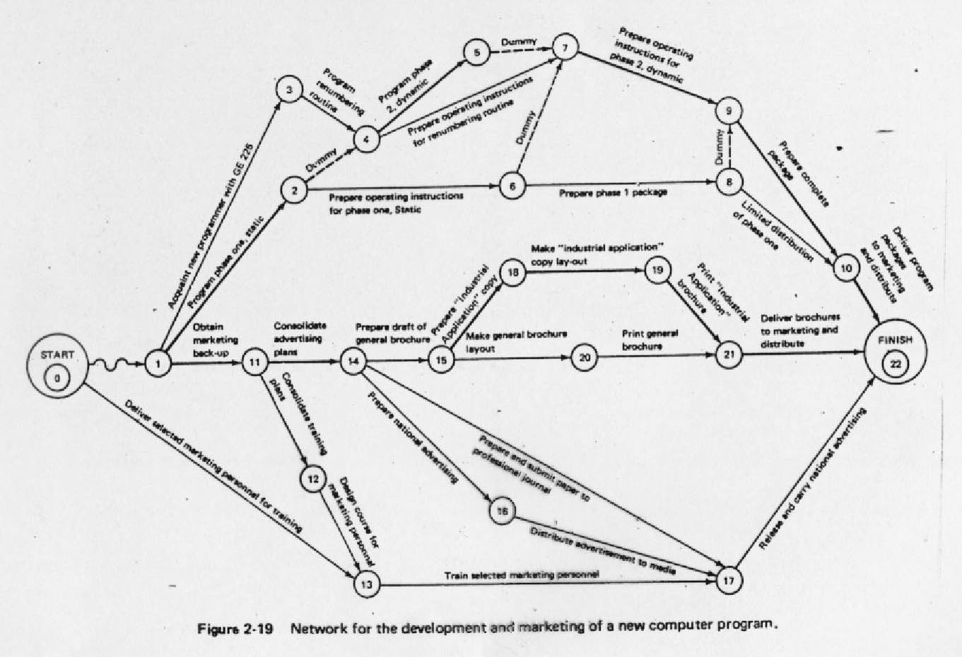
Example of Network – More Complex

Slide 19
DEFINITION OF TERMS IN A NETWORK
Activity : any portions of project (tasks) which required by project, uses up resource and consumes time – may involve labor, paper work, contractual negotiations, machinery operations Activity on Arrow (AOA) showed as arrow, AON – Activity on Node
Event : beginning or ending points of one or more activities, instantaneous point in time, also called ‘nodes’
Network : Combination of all project activities and the events
PRECEEDING
SUCCESSOR
ACTIVITY
EVENT

Slide 20
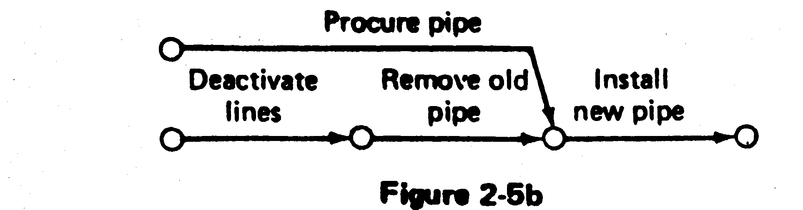
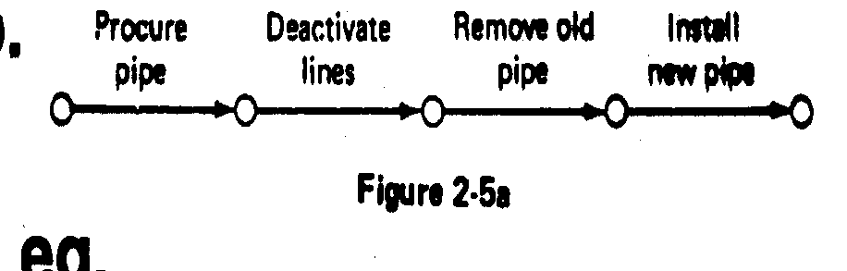
Emphasis on Logic in Network Construction
Construction of network should be based on logical or technical dependencies among activities
Example - before activity ‘Approve Drawing’ can be started the activity ‘Prepare Drawing’ must be completed
Common error – build network on the basis of time logic (a feeling for proper sequence ) see example below
WRONG !!!
CORRECT ✓

Slide 21
PERT
Project Evaluation and Review Technique (PERT) is a procedure through which activities of a project are represented in its appropriate sequence and timing.
It is a scheduling technique used to schedule, organize and integrate tasks within a project
PERT is basically a mechanism for management planning and control which provides blueprint for a particular project
In this technique, a PERT Chart is made which represent a schedule for all the specified tasks in the project

Slide 22
CPM
CPM is a technique which is used for the projects where the time needed for completion of project is already known.
It is majorly used for determining the approximate time within which a project can be completed.
Critical path is the largest path in project management which always provide minimum time taken for completion of project

Slide 23
Example 1- A simple network
Consider the list of four activities for making a simple product:
Activity Description Immediate
predecessors
A Buy Plastic Body -
B Design Component -
C Make Component B
D Assemble product A,C
Immediate predecessors for a particular activity are the activities that, when completed, enable the start of the activity in question.

Slide 24
Sequence of activities
Can start work on activities A and B anytime, since neither of these activities depends upon the completion of prior activities.
Activity C cannot be started until activity B has been completed
Activity D cannot be started until both activities A and C have been completed.
The graphical representation (next slide) is referred to as the PERT/CPM network

Slide 25
Network of Four Activities
Arcs indicate project activities
A
D
1
3
4
B
C
2
Nodes correspond to the beginning and ending of activities

Slide 26
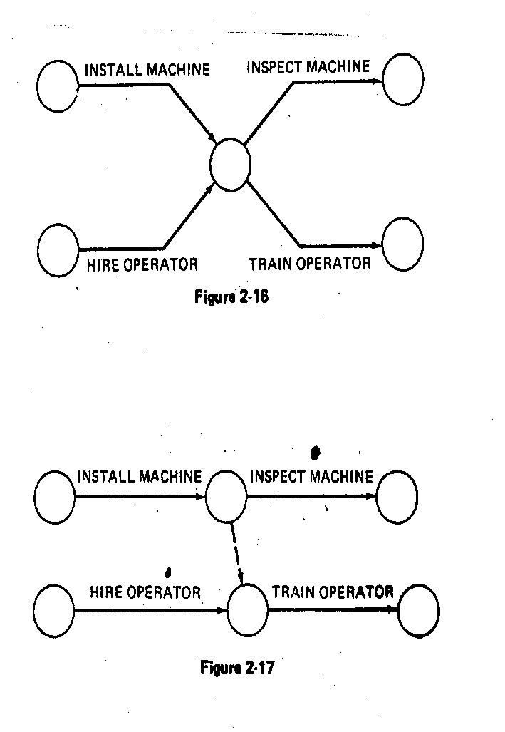
EXAMPLES OF THE USE OF DUMMYACTIVITY
Network concurrent activities
a
a
2
1
2
1
Dummy
b
b
3
WRONG!!!
RIGHT ✓
Activity c not required for e
WRONG !
a
a
d
e
1
b
1
e
b
c
d
2
c
WRONG!!!
RIGHT ✓
RIGHT ✓

Slide 27
WRONG!!!
RIGHT!!!
a
d
a
d
1
1
b
e
b
2
2
4
e
c
f
c
3
f
3
a precedes d.
a and b precede e,
b and c precede f (a does not precede f)

Slide 28
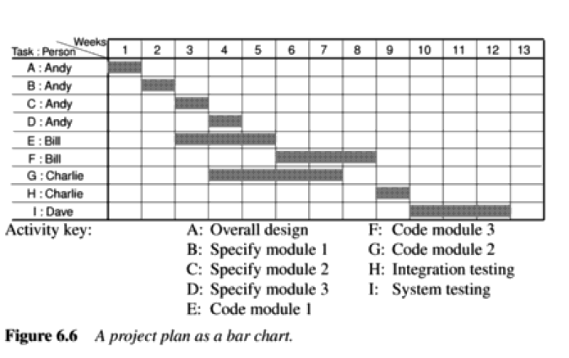
Simple sequencing

Slide 29
CPM Network
A project network should have only one start node
A project network should have only one end node
A link has duration
Nodes have no duration
Precedents are immediate preceding activities
Time moves from Left to Right
Nodes are numbered sequentially
A network should not contain loops
Leads to an impossible sequence
A network should not contain dangles

Slide 30
CPM Convention
Event
Number
Earliest
date
Latest
date
Slack

Slide 31
Example to construct a CPM
Id. | Activity Name | Duration (weeks) | Precedents
A | Hardware selection | 7
B | Software design | 4
C | Hardware Installation | 6 | A
D | Coding | 4 | B
E | Data Preparation | 5 | B
F | User Documentation | 9
G | User Training | 5 | E,F
H | System Installation | 3 | C,D

Slide 32
Cont…
2
7
7
0
C=6
A=7
1
B=4
3
D=4
5
H=3
6
0
0
4
6
13
13
16
16
0
2
0
0
E=5
F=9
4
G=5
9
11
2

Slide 33
Cont…
2
7
7
0
C=6
A=7
1
B=4
3
D=4
4
H=3
6
0
0
4
6
13
13
16
16
0
2
0
0
E=5
F=9
5
G=5
9
11
2

Slide 34
Critical Path
Any delay in critical path delays the project
Slack= difference between earliest and latest dates
Any event with slack 0 is critical.
Path joining these events is critical path
Activity float
Float=difference in earliest finish and it’s latest start

Slide 35
Adding the time dimension
Critical path approach is concerned with:
Project completed as quickly as possible
Identifying activities leads to delay project or later activities start date, if delayed.
Forward pass
Earliest dates of activities
Backward pass
Latest start dates and the critical path

Slide 36
Cont…
Loop representing impossible sequencing
Code Program
Test Program
Release Program
Diagnose Errors
Correct Error

Slide 37
Cont…
Dangling activities indicate errors in logic
Design Program
Code Program
Test Program
Install Program
Write User Manual

Slide 38
Cont…
Solution is:
Remove dangle activities
If that is a part of project => re-draw the network
Design Program
Code Program
Test Program
Install Program
Write User Manual

Slide 39
Significance of critical path
During planning stage
Shortening the critical path will reduce the overall project duration
During management stage
Pay more attention to those activities which fall in the critical path
Notes:
Actually, it is the shortening of the critical activity by putting more resources in it.
The CPM allows you to identify what to shorten. However, it does not tell you how to.

Slide 40
Risk Management

Slide 41
Risk
An uncertain event or condition that,
if it occurs, has a
positive or
negative effect on a project’s objectives.
Risk relates to future
It involves cause and effect

Slide 42
Risk Categorization
Risk management is considering uncertainty remaining after a plan has been formulated.
Project risks
Business risks
Notes:
Project risks: prevent the achievements of the objectives given to the project manager and the team
Business risks: like e-commerce web site is designed correctly but customers fail to the use of site due to uncompetitive price demanded.

Slide 43
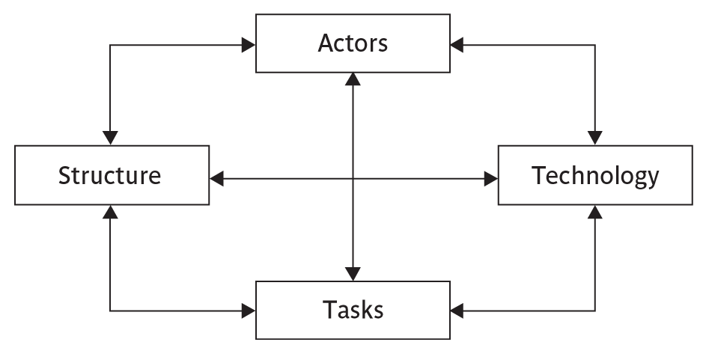
Cont…
Notes:
Actors relate to all those involved in the project including both developers, users and managers e.g. a risk could be that high staff turnover leads to information of importance to the project being lost
Technology – both that used to implement the project and that embedded in the project deliverables – risk could be that the technologies selected are not in fact appropriate.
Structure – this includes management procedures, risk here is that a group who need to carry out a particular project task are not informed of this need because they are not part of the project communication network
Tasks – the work to be carried out. A typical risk is that the amount of effort needed to carry out the task is underestimated.
A risk could be well belong to more than one of the four areas – for example, estimates being wrong could be influenced by problems with actors (e.g. lack of experience with a technical domain) or the structure (over optimism of managers keen to win work).
Exercise 7.2 in the text will be some practice in identifying and categorizing risks

Slide 44
Nature of risk
Estimation Errors
Planning assumptions
Eventualities
Unexpected events

Slide 45
Risk Management
Risk Identification
Checklist
Brainstorming
Risk Estimation
Likelihood
Impact
Risk Evaluation
Risk Planning

Slide 46
Cont…
Risk Control
Aspects of quality control
Risk Monitoring
Risk directing and
Risk staffing

Slide 47
Cont…
Risk
engineering
Risk
analysis
Risk
management
Risk
planning
Risk
control
Risk
monitoring
Risk
identification
Risk
estimation
Risk
evaluation
Risk
staffing
Risk
directing

Slide 48
Evaluating risks to the scheduling

Slide 49
Using PERT
Most likely time (m)
Normal condition time
Optimistic time (a)
Shortest time
Pessimistic time (b)
Worst possible time

Slide 50
Single expected duration(t_{e})
t_{e}= (a+4m+b)/6

Slide 51
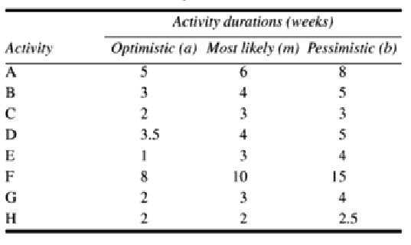
Using expected duration

Slide 52
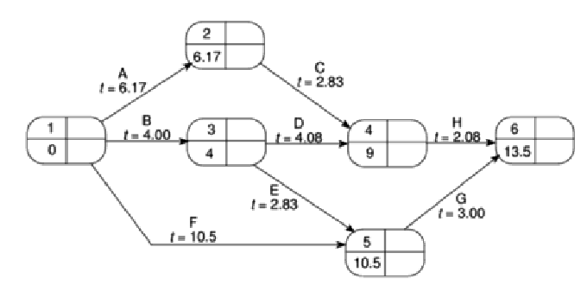
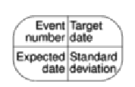
Cont…

Slide 53
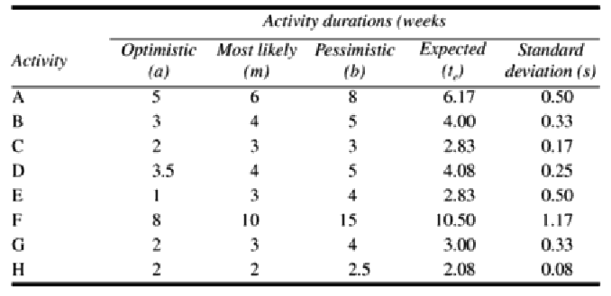
Standard Deviation(s):
S=(b-a)/6

Slide 54
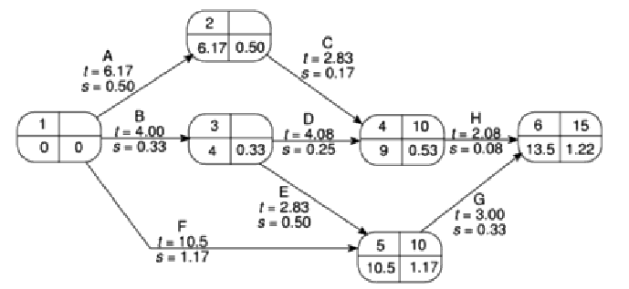
Cont…

Slide 55
Calculating the Z value:
Z=(T-t_{e})/s

Slide 56
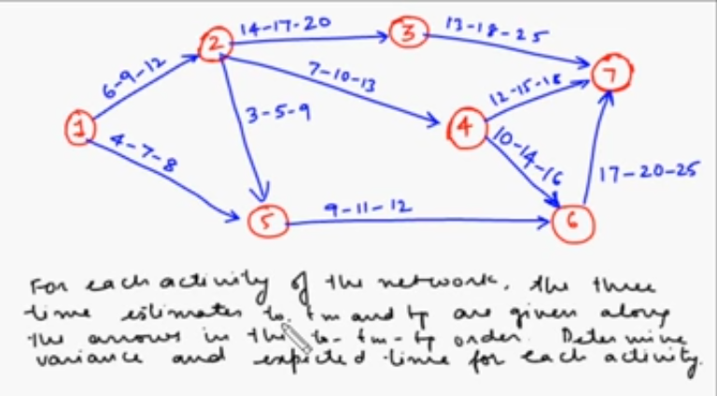

Slide 57
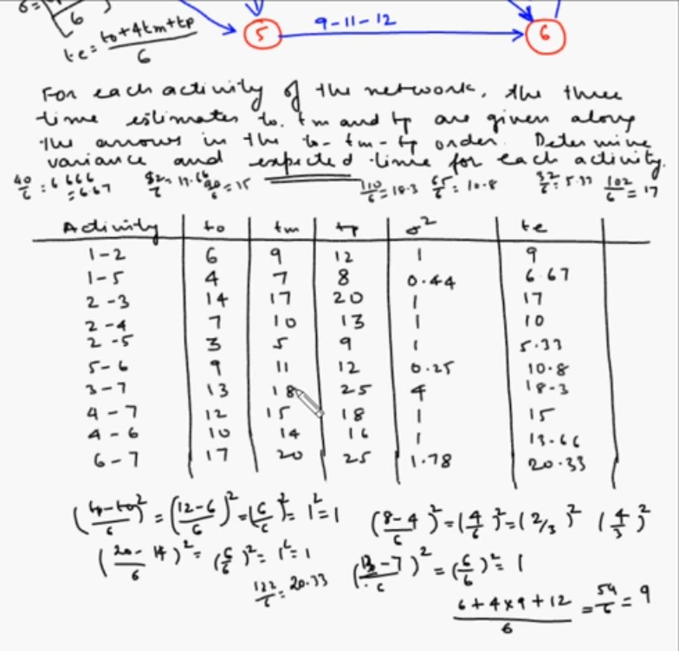

Slide 58
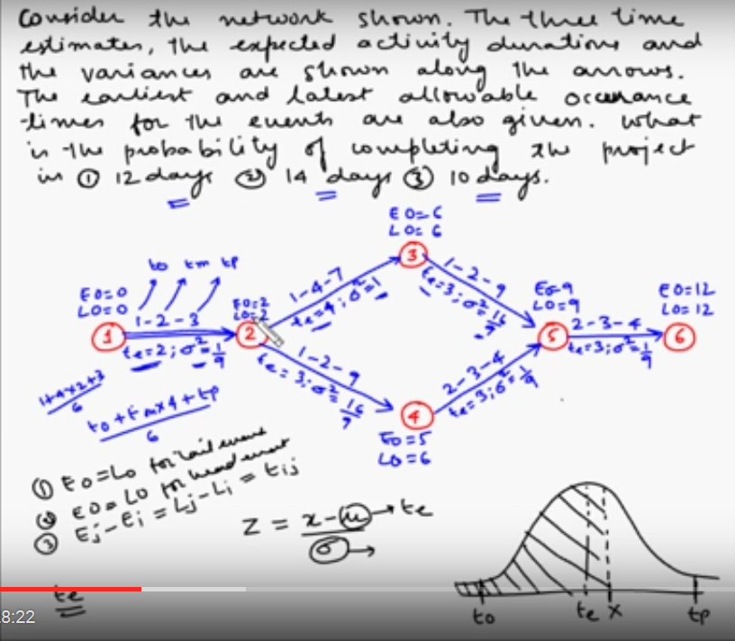

Slide 59
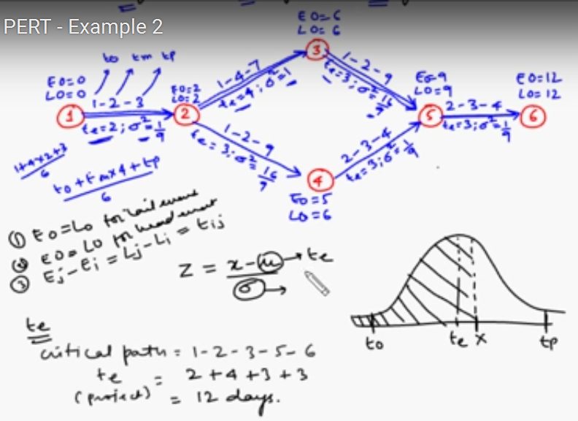

Slide 60
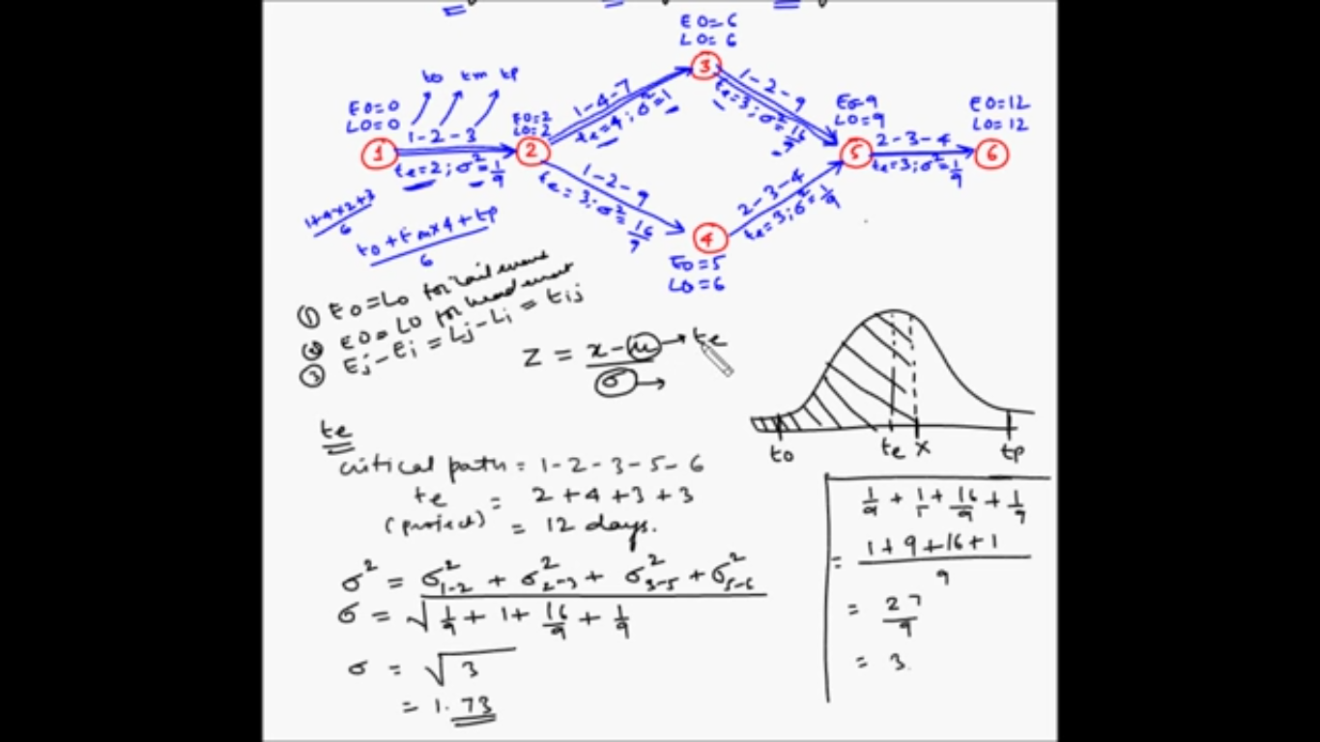

Slide 61
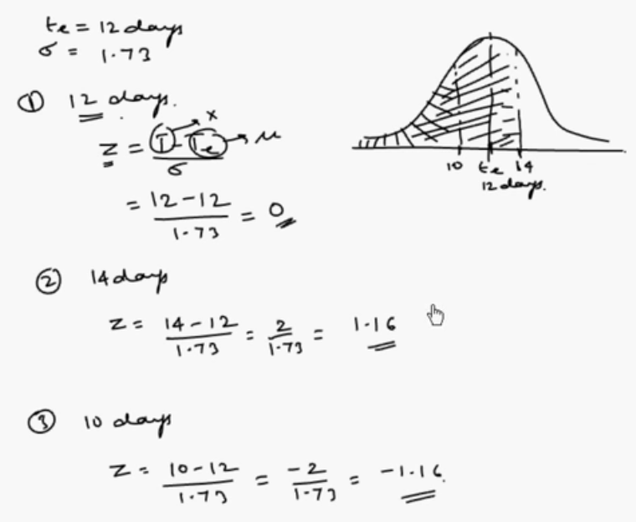

Slide 62
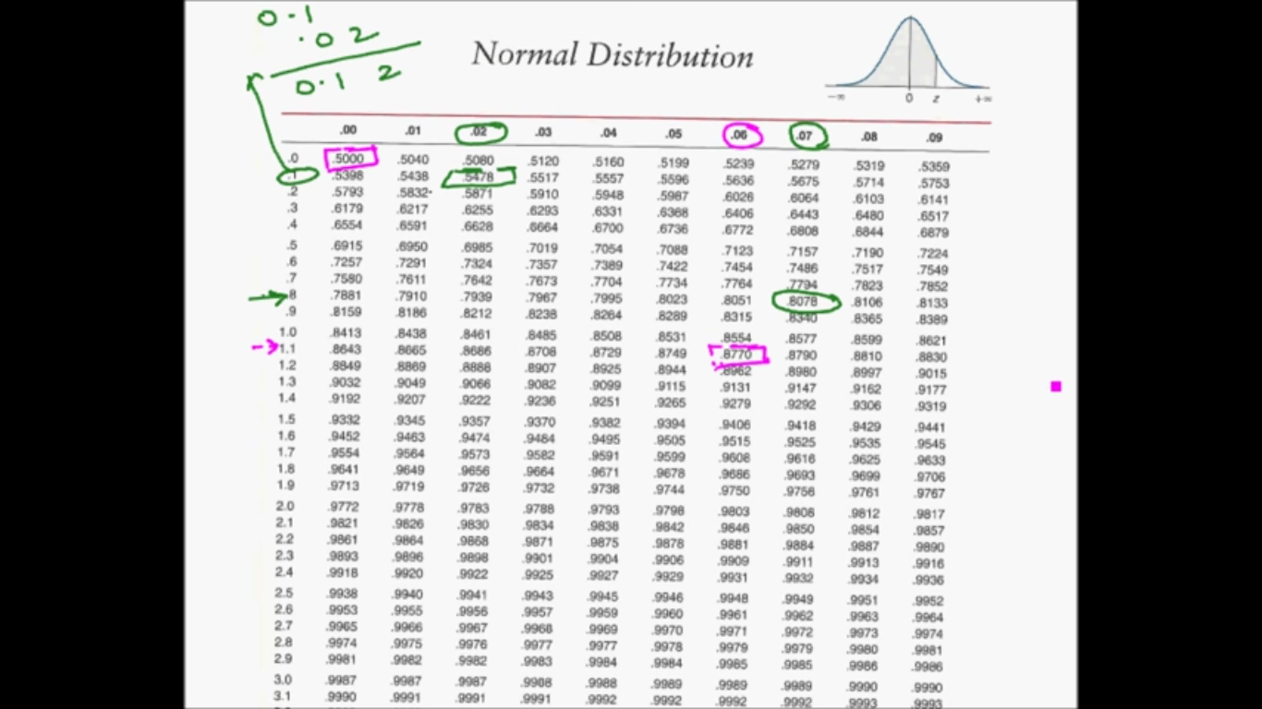

Slide 63
